Slide 2
Recap
What are List and Tuple
Difference between list and tuple
Create sub list/tuple from list and tuple
Changing a value of an element in a list
Adding and deleting element in a list
Basic operations of list/tuples

Slide 3
Datatypes 3
Dictionaries

Slide 4
Dictionaries
What is dictionary?
It is like a real life dictionaries having a meaning (value) to a specific word (key).
Dictionary in python stores value in key-value pair.
Enclosed in curly brackets {}
Key-value pair 1
Key-value pair 2

Slide 5
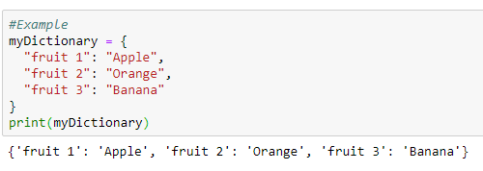

Dictionaries
Values of a dictionary are accessed by their “keys” instead of index. Just like search the words in dictionary

Slide 6

Rules - Dictionaries
Cannot access elements by index (different from lists)
Cannot have duplicate keys

Slide 7
Practise time!
Answer the questions in the notebook
Ask me at any time when you’re unsure or not clear
When all the questions are finished, call me to check :D

Slide 8
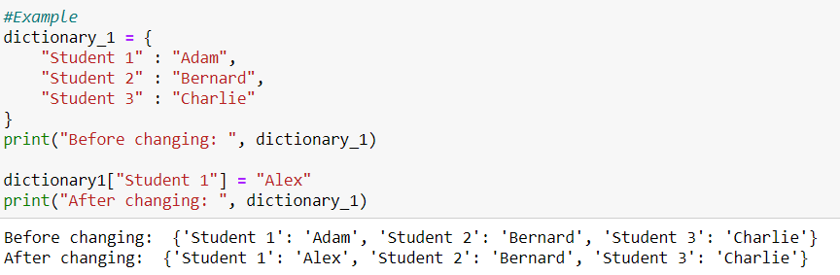
Changing values - Dictionaries
Similar to a list, values of dictionaries can also be changed in a similar way.

Slide 9
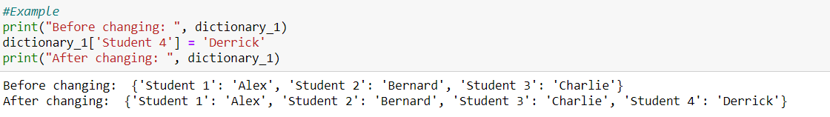
Adding new key-value pairs- Dictionaries
To add new key-value pairs, you can do it by
dictionary['new_key'] = 'new_value'

Slide 10
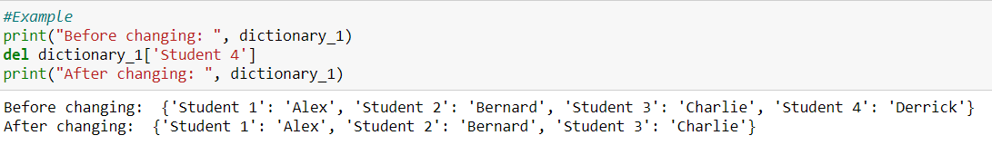
Removing new key-value pairs- Dictionaries
To removing new key-value pairs, you can do it by
del dictionary['key']

Slide 11
Practise time!

Slide 12
Nesting - Dictionaries
Dictionaries can be nested!
What is nested?
It means a dictionary within another dictionary!
It is very commonly used in python!

Slide 13
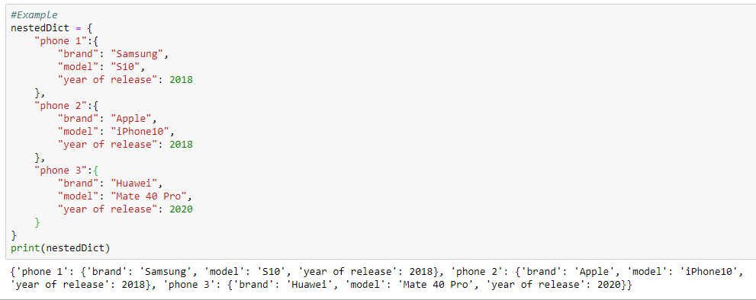
Nesting - Dictionaries

Slide 14
Nesting - Dictionaries
How do we access its values then?

Slide 15
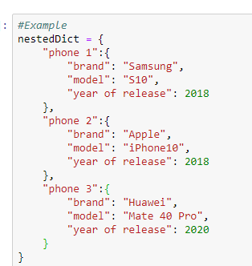

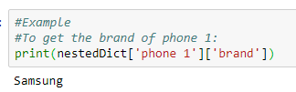
Nesting - Dictionaries

Slide 16
Practise time!

Slide 17
Questions?

Slide 18
Thinking question: Does nesting only applies to dictionary?

Slide 19
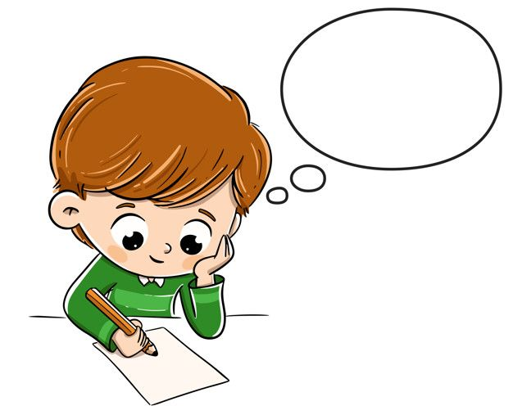
Todays Lesson…
What is a dictionary
Access the value of an element in a dictionary
Changing a value of an element in a dictionary
Nested dictionary

Slide 20
THANK YOU!

